Slide 1

Voice of Silence
Hear them with your eyes.
A minor project for a major cause
Rahul Tuteja 14BCS0045
Saif Rehman Nasir 14BCS0007
Anish Sharma 14BCS0039
Notes:
To use this title animation slide with a new image simply 1) move the top semi-transparent shape to the side, 2) delete placeholder image, 3) click on the picture icon to add a new picture, 4) Move semi-transparent shape back to original position, 5) Update text on slide.

Slide 2
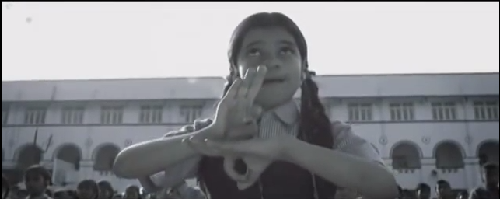
When eye rolls to make a statement and hand moves to create words.

Slide 3
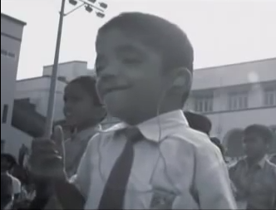
Sign Language Interpreter
Our Aim
Making an application that translate the Sign language into English Language.
We are doing it to abridge the gap between the disable people and those who can speak.
So that they have a voice too.
May this noble effort blooms into intended reality.
Interpret the sign
A meaning to meaninglessness

Slide 4
Just See
Bird eye’s view
What
An application that takes a sign language video as its input and produce a video with subtitles against the gestures
How
Machine learning using python.
Android
Why
Because we must hear the every voice.

Slide 5
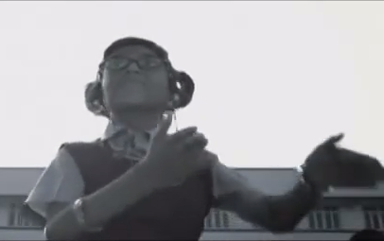
Easier said than done.
How
?

Slide 6
THE STAGE HAS BEEN SET
Our Five steps
1
2
3
4
5
Make an interface (Android) to feed input video
A machine that knows the sign language
Pass video to machine. Divide it into frames.
Generate text as output against each frame
Interface app receives the text.
Put the corresponding text against the frame.
Our output video has been produced.
Reference : The basics you can find anywhere 5 Steps To Successful Storytelling Published on April 5, 2014 Featured in: Marketing & Advertising

Slide 7
That’s how gentlemen
Android app takes the text.
And put it on corresponding frames.
Android Interface .
Take input
Use the machine to generate text against video frames.
A Machine that knows Sign Language
Voila!

Slide 8
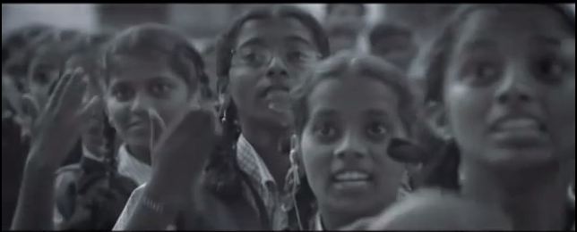
Let us address the elephant in the room.
Machine learning fine,
but how??

Slide 9
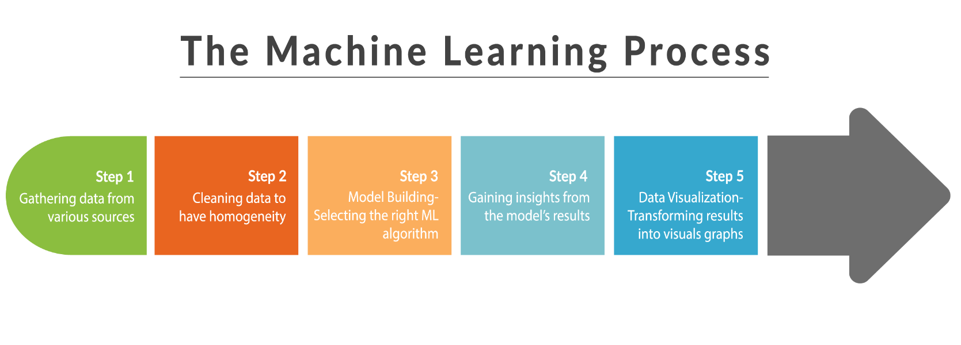
K-nearest Neighbor Algorithm
Logistic Regression Algorithm
Support Vector machines
USING image Processing tools like OpenCV

Slide 10
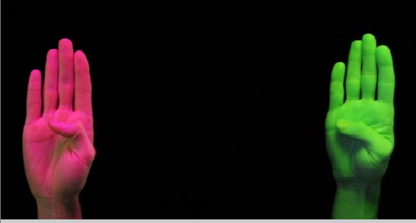
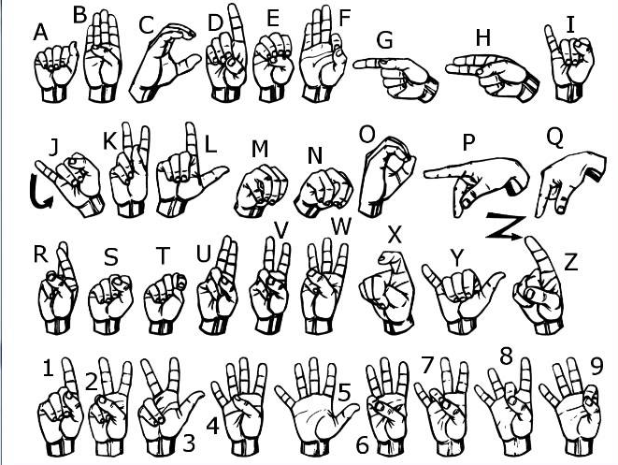
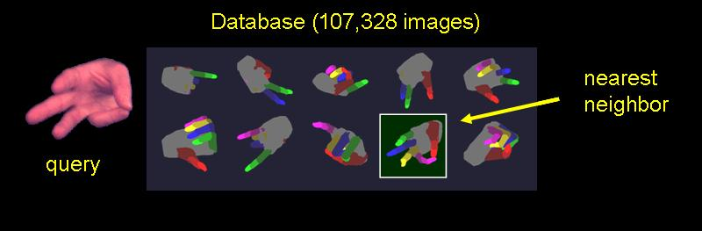
In action

Slide 11
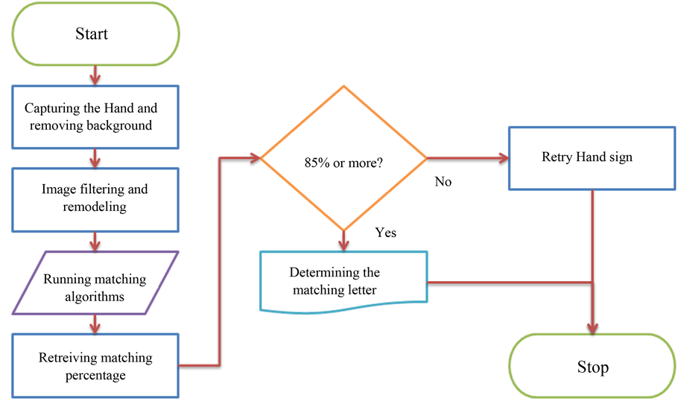
A closer Perspective
Notes:
Tip:
When using complex image as full-bleed background add a transparency (70%-90%) fill layer to give contrast to text.

Slide 12
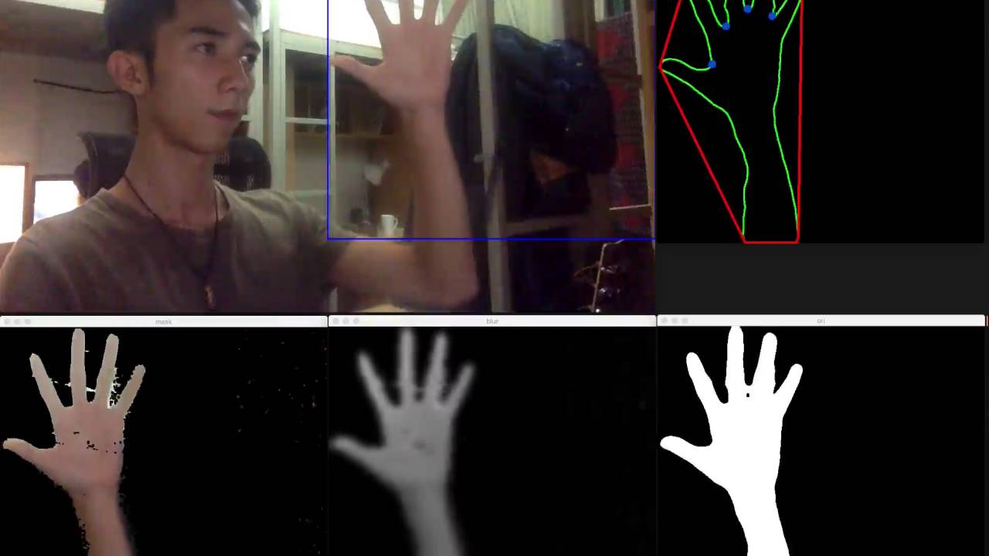
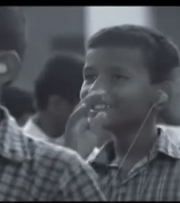
4
Show, don’t tell
ENGAGE
Visualize key messages
A picture is worth a thousand words…
Make a statement
Using graphics, charts, and infographics

Slide 13



Tools and platforms
Etc…

Slide 14
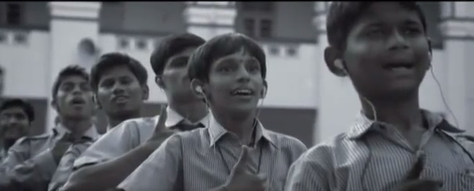
May technology bridge the gap.
Notes:
Combine an image and multiple key statements with a strong grid.

Slide 15
And so it ends…
THANK YOU

